Slide 1
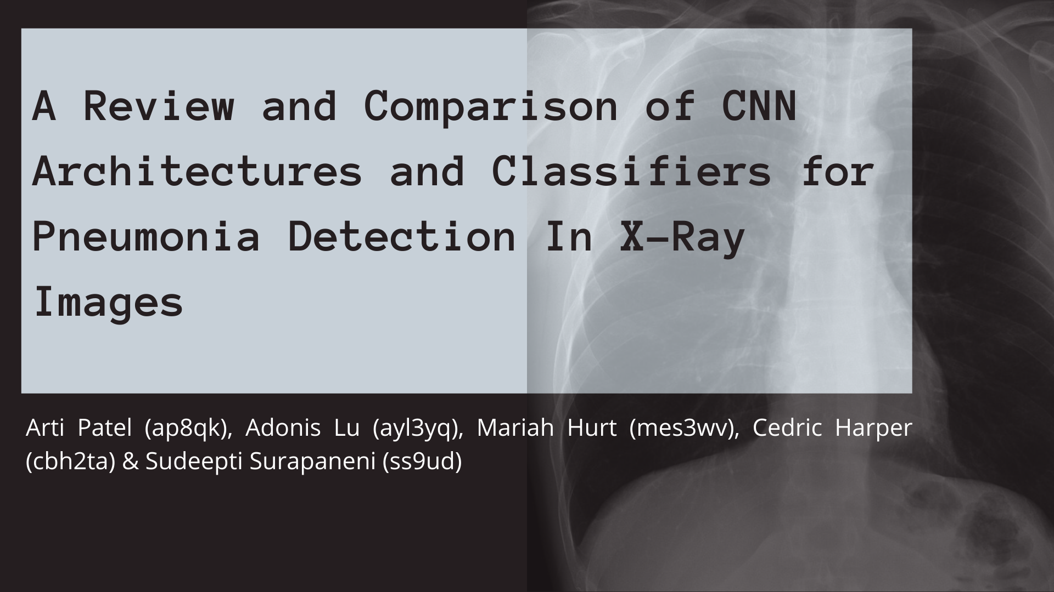

Slide 2
Introduction
The use of CNNs in classifying medical images is of great interest, especially in areas with limited resources it is used to assist but not replace doctors
Even prior to our current pandemic situation, pneumonia is a leading cause of mortality worldwide
At this time most studies of this type are focused on feasibility of models not deployment, our dataset is not varied enough to make claims about the generalizability of any of our models
Notes:
Mariah
-The use of convolutional neural networks in classifying medical images is of great interest especially in areas with limited resources, it is used to assist but not replace doctors.
-Even prior to the current pandemic situation pneumonia is a leading cause of mortality worldwide
-In a review of studies designed to investigate the use of AI or computer vision in medical diagnostics, it was found that only 6 percent used an external validation set which is necessary for deploying a diagnostic tool in the field, while most studies were focused on implementing algorithms to investigate the feasibility of a diagnostic tool [1]. Our study fits is also investigating feasibility - the dataset has been cleaned of low-quality scans and all the scans come from the same medical institution which makes it impossible to claim that any algorithm resulting from this study would be ready for testing in other medical institutions [1][2].
-Machine learning applications are being studied for more than just diagnostics in medical imaging, with studies on image restoration, segmentation, and de-noising being of great interest as well [3]. Due to the nature of our dataset and our objective, we will focus on predictive diagnostic applications.

Slide 3
Literature Review Findings
In the medical field, CNNs and transfer learning with pre-trained architectures are common
Previous studies have found AlexNet and GoogleNet for medical images
ResNet50 study focused on chest x-rays (quite similar to our project)
Multiclass classification that focused on more than just pneumonia, low sample sizes for some
Training a network from scratch
Pre-trained CNNs (e.g. VGG, AlexNet, DenseNet) + classifier
CheXNet performed nearly as well as radiologists
Xception
VGG19 and MobileNet v2 on COVID patients
Reducing image size to lessen computational cost
Notes:
Adonis
I can just go through this if nobody else wants to -adonis
It’s basically just a summary of the paper findings

Slide 4
VGG, InceptionV3, AlexNet
AlexNet
Pros:
For its time, its use of ReLU activation function was revolutionary, lessening the vanishing gradient problem
adding dropout function to lessen overfitting
Multi-gpu training
Cons:
Has potential to overfit and computationally expensive
Notes:
Used 3 main NN architectures
Wanted to go through some of the pros and cons of each
Alexnet was originally used in the image net challenge
Used ReLu and then dropout which was fairly new at the time
A drawback is that it does overfit and can be computationally expensive

Slide 5
VGG, InceptionV3, AlexNet
InceptionV3
Pros:
concatenates feature-maps produced by filters of different sizes
Designed to perform well under memory constraints and computational budget
Cons:
Harder to make changes to network because of the complexity of its architecture
VGG
Pros:
Required less epochs to converge than AlexNet due to implicit regularization and pre initialization of certain layers
Cons:
Had greater depth than AlexNet
Employed three times more parameter than AlexNet
Notes:
Cedric
InceptionV3 was developed by google in a series of NNs that they were developing
Improves on AlexNet
Performs well under memory and computational budget constraints
Harder to make changes to because the complexity of its architecture
VGG converges in fewer epochs than AlexNet
Does have greater depth
Employs more parameters than AlexNet
Alexnet background info:
https://papers.nips.cc/paper/4824-imagenet-classification-with-deep-convolutional-neural-networks.pdf
https://towardsdatascience.com/alexnet-the-architecture-that-challenged-cnns-e406d5297951

Slide 6
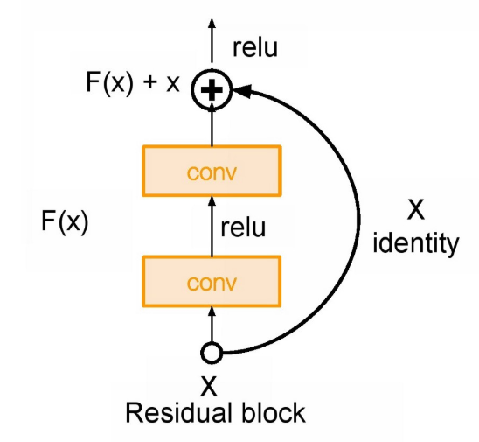
Other Potential Methods: ResNet
ResNet seeks to address the vanishing gradient issue (due to repeated multiplication) especially with networks that featured many layers
“Identity shortcut connection” that can skip layers
Stacking identity mappings should not degrade performance
Notes:
adondon

Slide 7
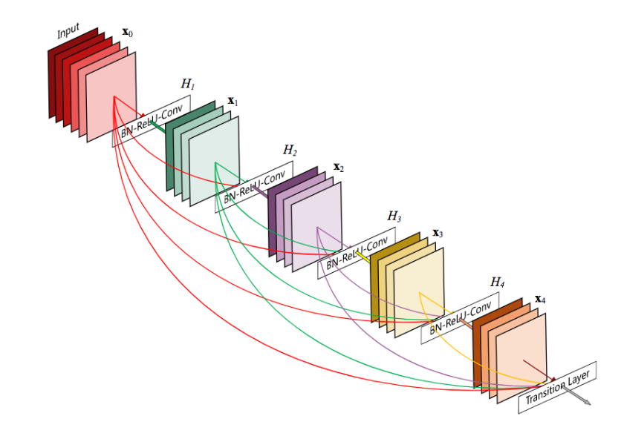
Other Potential Methods: DenseNet
DenseNet is similar, now all layers are connected to each other
Input of each layer is the feature maps of all earlier layers
Output is passed to all subsequent layers
Parameter efficient, since features are often reused
Notes:
adondon

Slide 8
Pre-Trained vs Training from Scratch
Training a neural network can take a very long time and be computationally expensive
More readily possible than a few years ago
Heavily depends on the size of the dataset
General lack of medical data, especially for rare diseases/conditions
Pre-Trained Requirements:
Same inputs (eg image recognition)
Pretrained dataset is much larger
Many existing pre-trained architectures to choose from!
Notes:
Adondon
I will talk about how these relate to medical field, which typically has less data

Slide 9
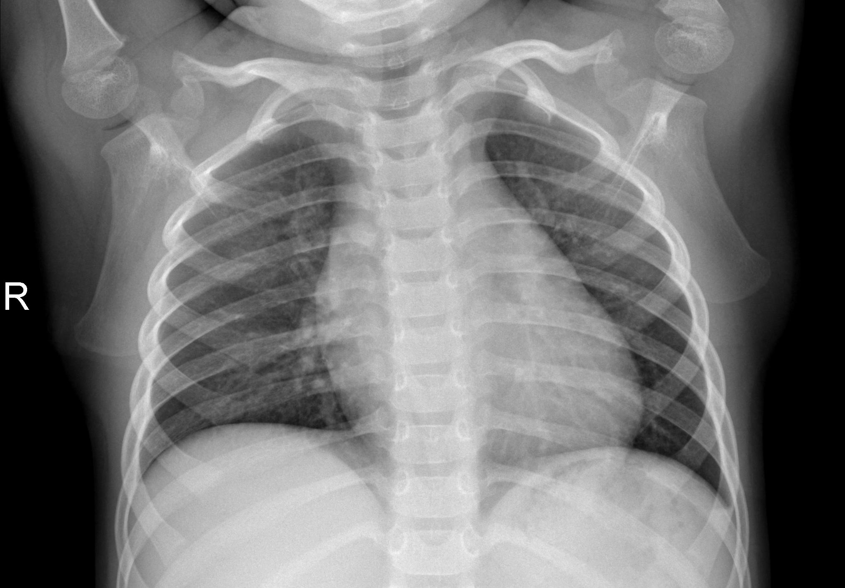
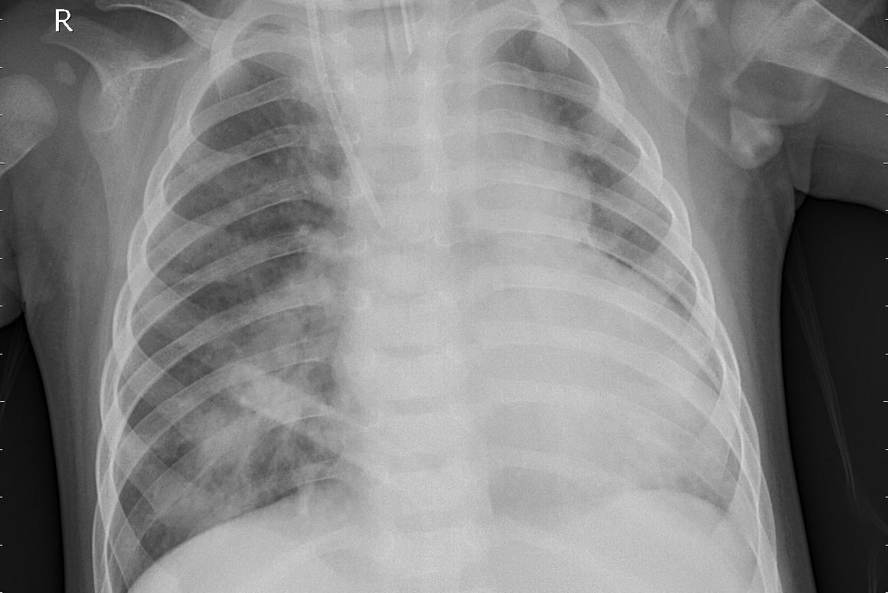
Data
NORMAL
PNEUMONIA
Notes:
Cedric
Just to give an example of the data we were classifying
Ww see a normal xray of the chest on the left depicting clear lungs without any areas of abnormal opacification(becoming cloud or opaque)
The image on the right shows pneumonia and exhibits focal lobar consolidation

Slide 10
Data
Size
5,863 X-Ray images (JPEG)
Source
Chest X-ray images (anterior-posterior) were received from cohorts of pediatric patients (ages 1-5) from Guangzhou Women and Children’s Medical Center.
Kaggle - 90/10 Train/Test split
Number of Classes (2)
Normal
Pneumonia
Test Set (63/37)
390 positive
234 negative
Train Set (74/26)
3875 positive
1341 negative
Notes:
Cedric?
all the chest radiographs were filtered as a part of the quality control process by removing all low quality or unreadable scans
The quality of the images were assessed by two expert physicians before being cleared for training the AI system. In order to account for any grading errors, the evaluation set was also checked by a third expert.

Slide 11
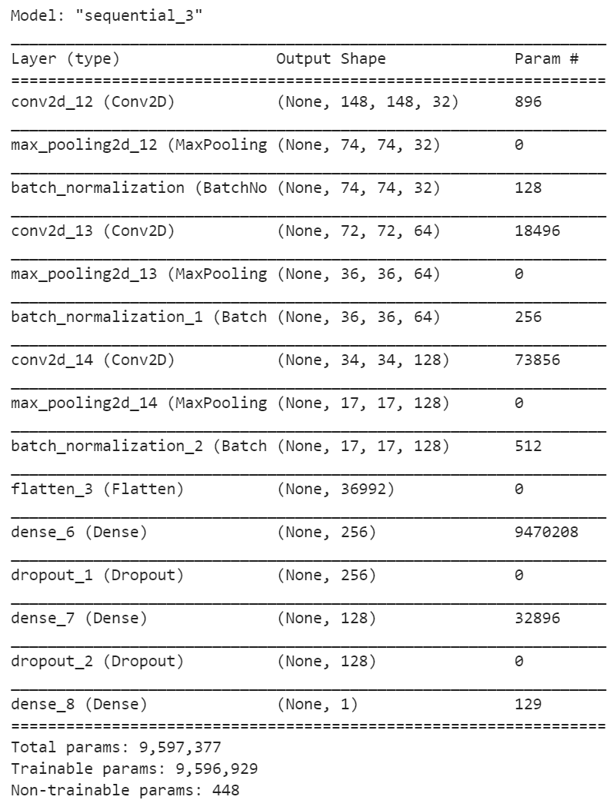
Base Custom Model
3 convolutional layers each followed with max pooling and batch normalization and ReLu activation
2 fully connected layers each with dropout rate of 0.5
Final sigmoid for binary classification
Image Augmentation:
Brightness scale 0.5-0.9, horizontal flip
Notes:
Arti
Our initial model didn’t have any regularization and ended with about 100% training accuracy but only about 80% of accuracy was retained in the validation set
We implemented a regularized model where we use dropout prevent overfitting
we use batch normalization to standardize the inputs of hidden layers for each batch
We tweaked a few versions of image augmentation and optimizers
RMS prop optimizer and 10e-4 learning rate
Brightness scale and horizontal flip - didn’t change the ballpark of the accuracy
Model summary; bullet points

Slide 12
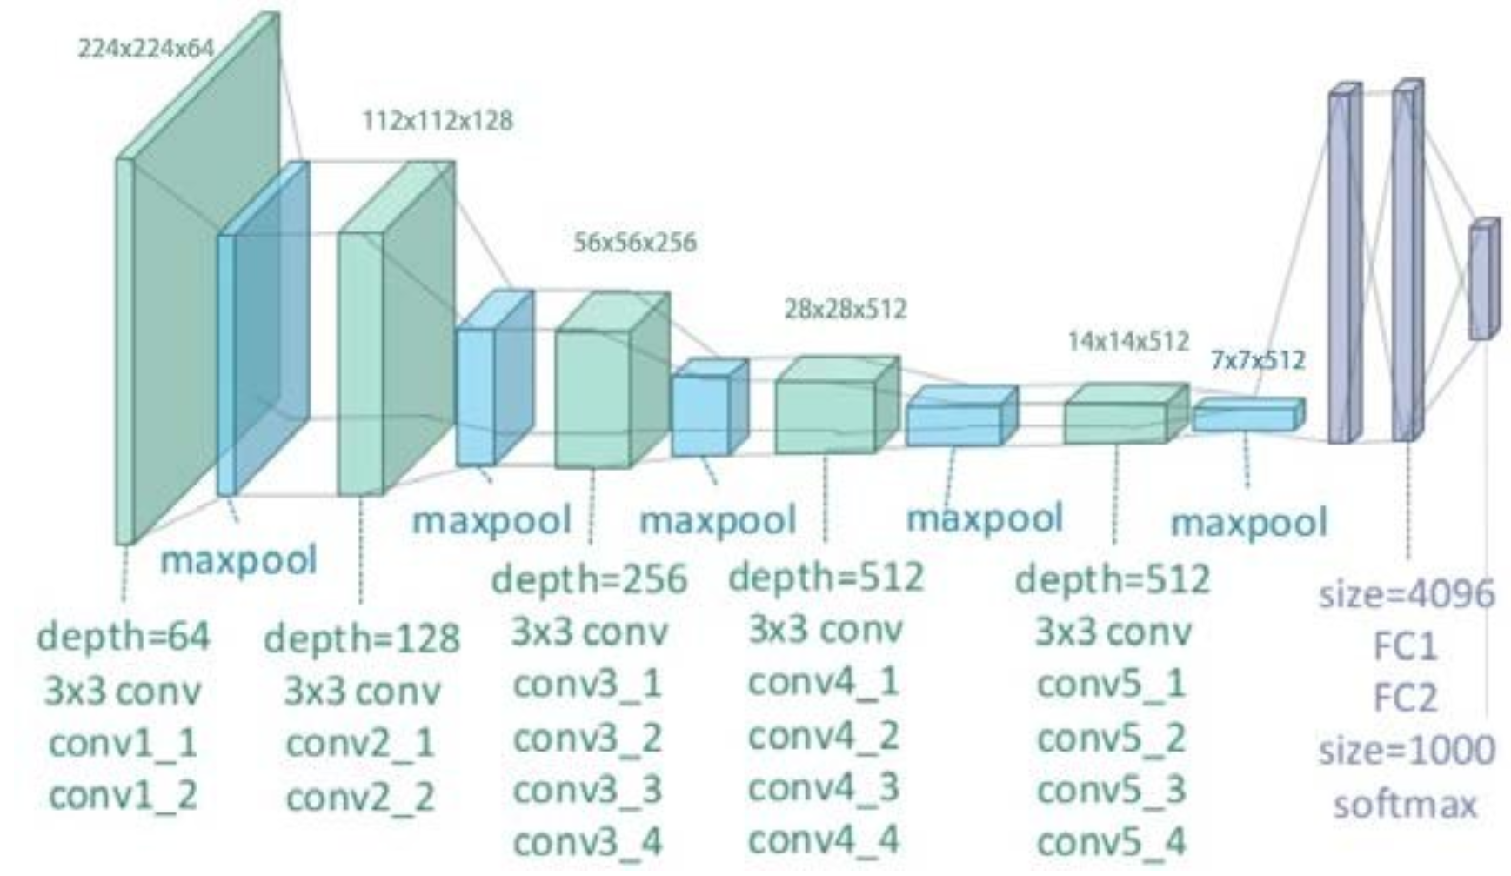
Methods - VGG19 Architecture
Notes:
Arti
Pre-trained on ImageNet (image database of 14,197,122 images)
https://www.researchgate.net/figure/llustration-of-the-network-architecture-of-VGG-19-model-conv-means-convolution-FC-means_fig2_325137356
Built off of AlexNet, has more depth
Two versions; bottleneck and finetune
Bottleneck we train a small model on top of the features learned from the VGG19 architecture. Small model consists of 1 dense layer, 1 dropout of 0.5 and then finally the sigmoid activation
The fine tuned model freezes the initial convolutional layers and only trained final layers and then also adds fully connected layers specific to our dataset. These final layers consisted of 2 dense layers each followed by a dropout of 0.5 and then a final sigmoid activation
Optimizer is RMSprop lr 2e-5
Both performed roughly the same

Slide 13
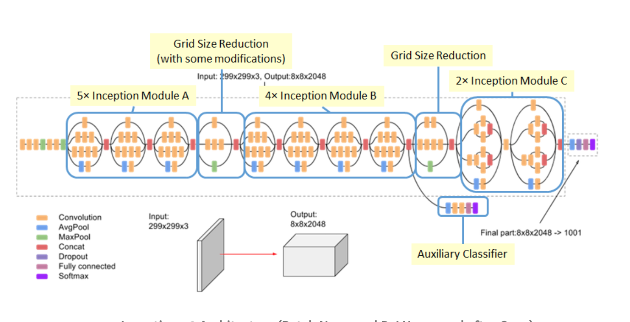
Methods - InceptionV3 Architecture
Notes:
Sudeepti
As a part of our comparative analysis, we also implemented inceptionv3 which is a widely-used and prominent CNN that is third iteration to have underwent refinements after InceptionV1 and InceptionV2. Researchers at Google created this model in hopes of creating a deep learning network that will avoid representational bottlenecks and to improve efficiency of computations by using factorization methods. Inception V3 consists of symmetric and asymmetric building blocks, including convolutions, average pooling, max pooling, dropouts, and fully connected layers. All convolutional layers are followed by batch normalization and ReLU activation. Inception V3 factorizes 5×5 convolution to two 3×3 convolution operations and replaces 7×7 to a series of 3×3 convolutions. Given these enhancements, InceptionV3 is proven to have a lower computation costs than VGGNet. We decided to use InceptionV3 because we found it to be a very effective and viable option for transfer learning - we adopted this transfer learning approach because we 1) are working with a small training set and 2) wanted to leverage the pre-trained weights and the pre-built architecture associated with InceptionV3.

Slide 14
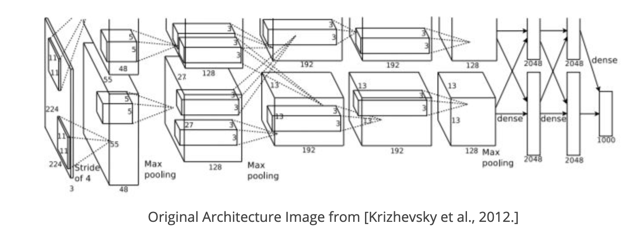
Methods - AlexNet Architecture
Notes:
Mariah
AlexNet is a convolutional neural network architecture developed by Alex Krizhevsky, Ilya Sutskever, and Geoffrey E. Hinton [10]. It’s a very famous and well known architecture in computer vision and it first became really well known in 2012 when it won an ImageNet Competition. A 2019 article from the Journal of Stomatal, Oral, and Maxillofacial Surgery reviewing the use of CNNs in medical image analysis found AlexNet to be one of the top performing architectures[4].It is composed of 5 convolutional layers followed by three fully connected layers, it utilizes relu as the activation function throughout and softmax as the final activation function. You can see by looking at the images of the network, that max pooling is used after three of the convolutional layers. The network does utilize dropout on the fully connected layers which the original AlexNet paper says is done to prevent overfitting [10].

Slide 15
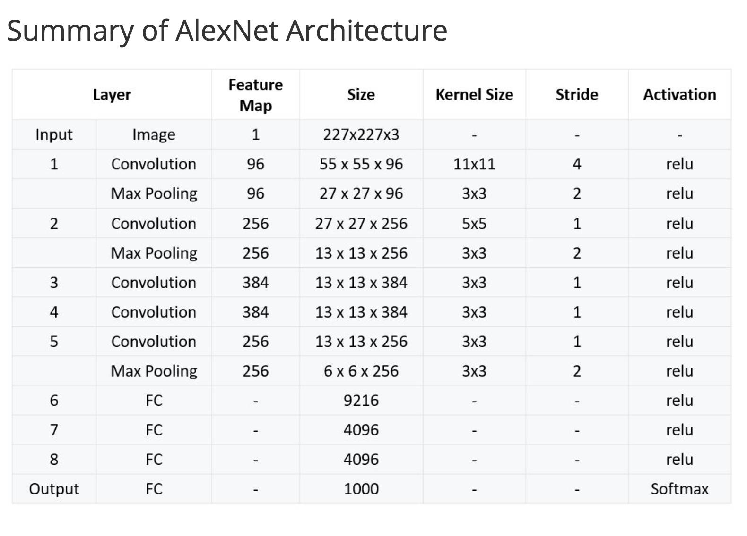
Methods - AlexNet Architecture
Notes:
Mariah
The architecture is simple enough to build in Keras, however doing that and training from scratch did not yield good results (at least over a short training span of 10 epochs). There is a GitHub Repo from MIT that has an AlexNet implementation in Keras but it is outdated and the file containing the pre-trained weights is in a format that doesn’t work with the current version of Keras. While a pre-trained AlexNet implementation is not available in Keras, it is available via PyTorch. AlexNet with weights from training on ImageNet data can be loaded as a model in PyTorch. Options to finetune are available. We explored how the network performed on the test set data with 10 epochs of fine-tuning on our set of training data.

Slide 16
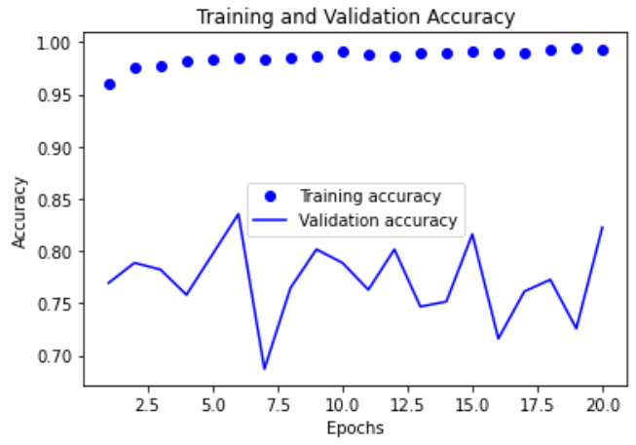
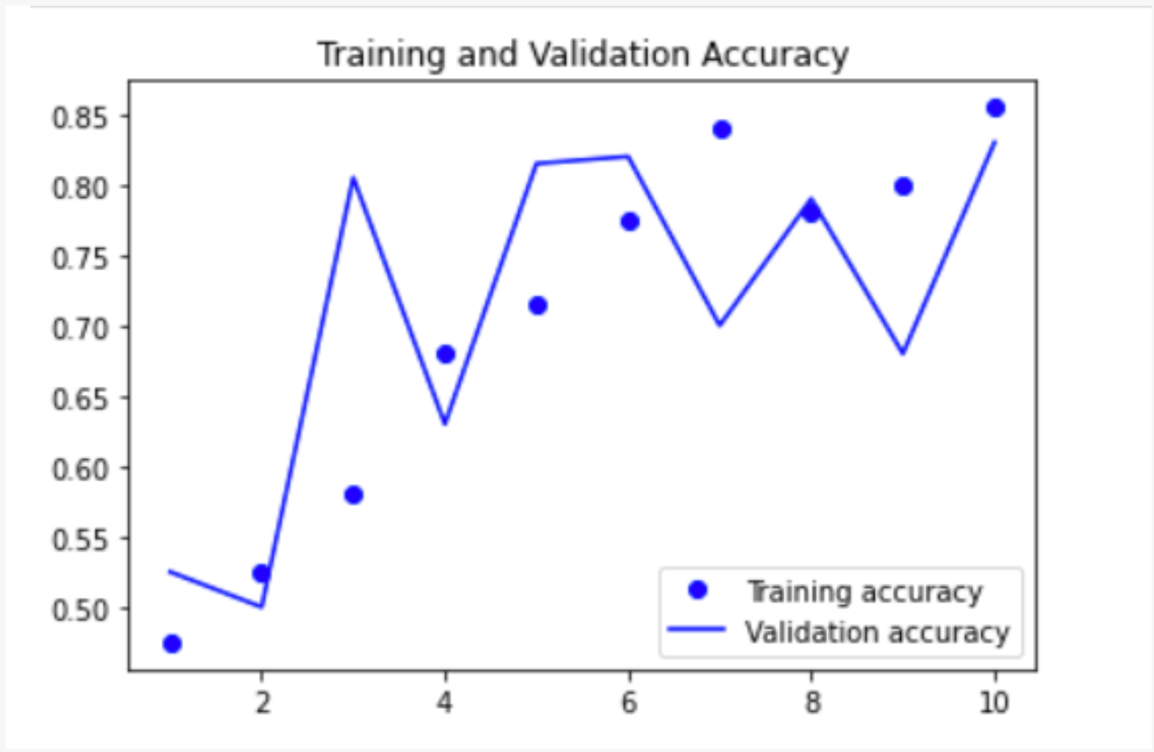
Results - VGG19
Freeze initial convolutional layers in VGG19 and add fully connected layers specific to dataset (fine-tuned VGG19)
Model is overfitted
Fine-tuned model is slightly better than the bottleneck
Right plot is accuracy after unlocking all layers
Notes:
Arti
Finetune - The fine tuned model freezes the initial convolutional layers and only trained final layers and then also adds fully connected layers specific to our dataset. These final layers consisted of 2 dense layers each followed by a dropout of 0.5 and then a final sigmoid activation
Plot on right shows the results when unlocking all of the layers and training using the VGG19 architecture - achieves about 85% for both training+val
Slightly better than bottleneck
Given more time, we could have experimented with more regularization techniques

Slide 17
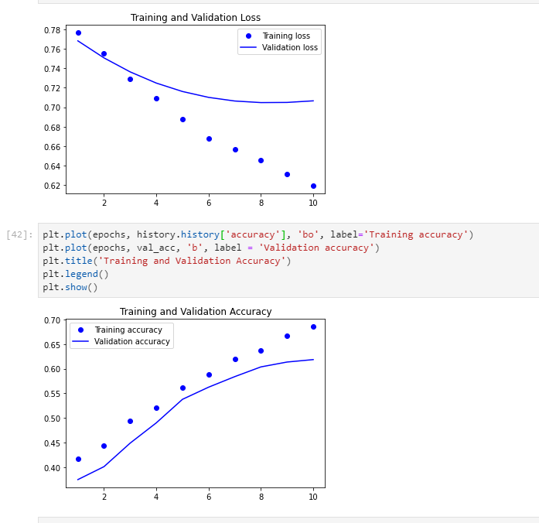
Results - InceptionV3
Notes:
Sudeepti
So moving on to the results of InceptionV3 -
We built a new model from the InceptionV3 by adding a new model with the original image input and the bottleneck layer from the InceptionV3 as output. Given that this was a binary classification problem, we inserted a sigmoid activation in the last (output) layer.
We adopted various approaches and tested different augmentation parameters and loss functions. For our final model, we decided to adopt specific parameters when augmenting the data that was proven to work for our dataset and achieved 89 percent accuracy in a paper - that focused on CNN based medical image classification for disease diagnosis.
The earlier iterations of our model were overfitting such that our training accuracy ranged 88 to 93 percent but our validation accuracy was ranging from 65 to 76 percent. For our final model (as pictured here), we lowered the learning rate to 1e-6 and tried to prevent overfitting to a certain extent. However, the accuracy seems to plateau.

Slide 18
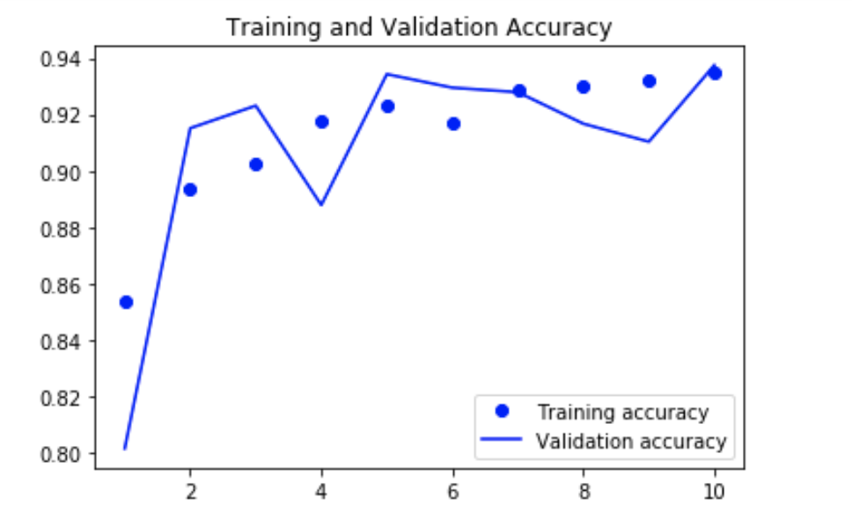
Results - AlexNet
Notes:
Mariah
We found that the pre-trained AlexNet network without any fine-tuning classified X-Ray images at a rate very close to random chance for a binary classification problem, with a 46% accuracy rate. We then turned to fine-tuning. We allowed the Alex-Net model with the pre-trained weights to train for 10 epochs on the training data. This greatly improved the accuracy to 93.7% on the testing data.

Slide 19
Grad-Class Activation Maps (Grad-CAMs)
Visual Explanations from Deep Networks via Gradient-based Localization
Increases model transparency and explainability
Visualizing activation areas will potentially allow domain experts (health professionals) to corroborate the model results based on common practices and guidelines
Notes:
Sudeepti
We wanted to qualitatively assess the performance of our multiple models by comparing the results of their application to select images within the dataset so we leveraged GradCAMS - which stands for Gradient-weighted Class Activation Mappings
GradCAMS provide a way to find out which part of an image the CNN classification model sees when it determines the class of an image. It specifically utilizes the gradient information about classes as it goes to the final layer of a CNN to create a rough localization map of the important regions in the image, based on its calculations of the most significant neurons for that class

Slide 20
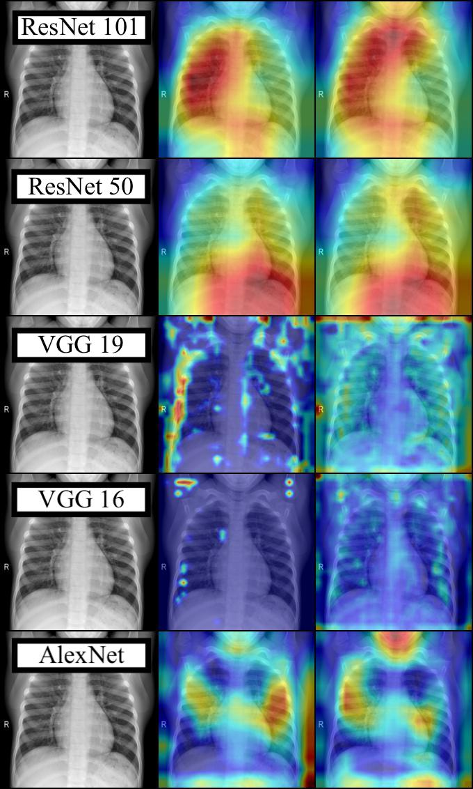
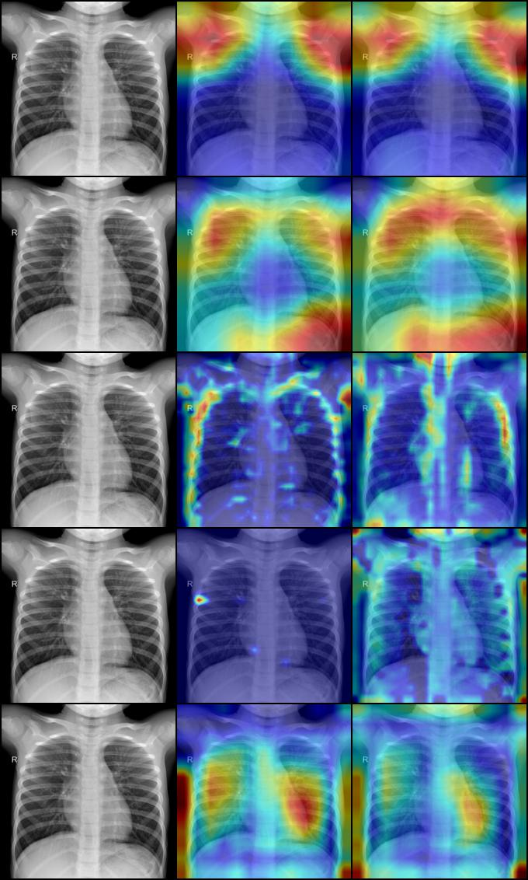
NORMAL
Notes:
Sudeepti
The Grad-CAM results were obtained by using the Pytorch
. After loading our ResNet 101, ResNet 50, VGG19, VGG16, and AlexNet models, we applied Grad-CAM functions.
We implemented the GradCAMS for these various CNN architectures by extracting the activation values from an intermediate convolution layer and using them to generate a heat map identifying the important areas of a given x-ray that the model deems most important while making the classification decision.

Slide 21
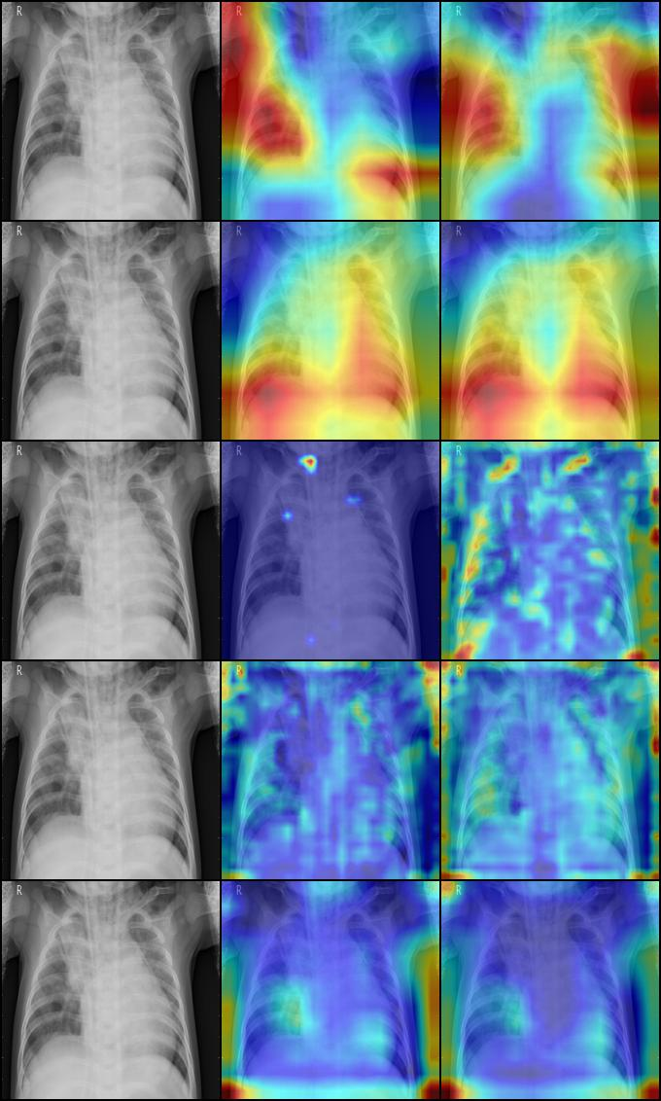
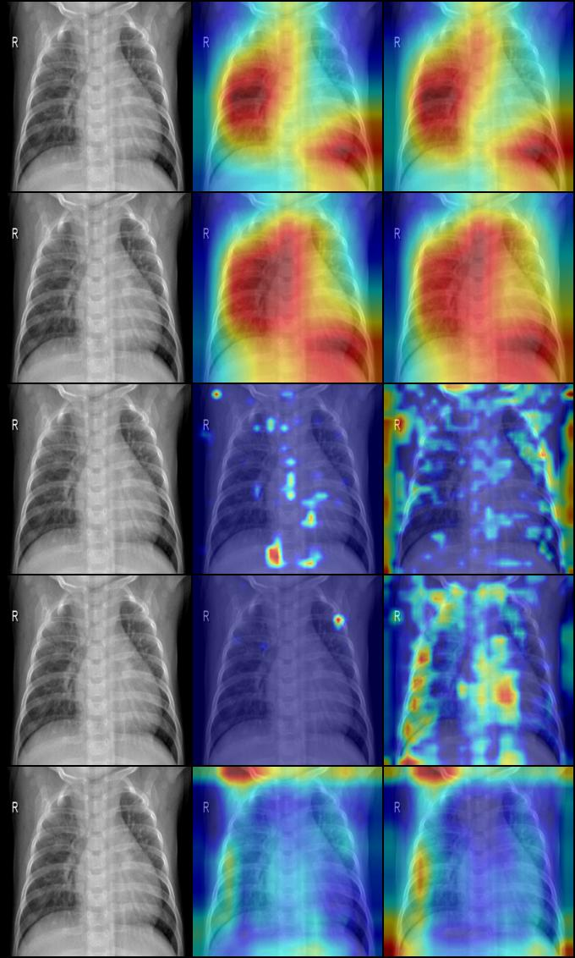
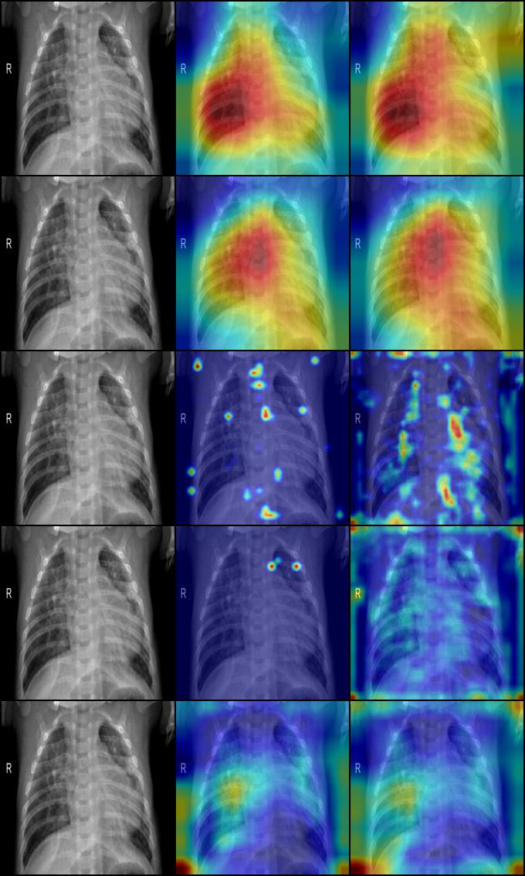
Notes:
Sudeepti
These are gradcams of x rays of patients who have pneumonia - as you can see resnet 101 and resnet 50 in addition to alex net place more importance where there are white blurry areas - indicating infection
Furthermore, we feel that these Grad-CAMS inject explainability and transparency to our models which is very important when building trust - with these applications. We compared various models using Grad-CAMS because we felt that visualizing activation areas will potentially allow domain experts to confirm if the models are classifying the images based on real anatomical and biological features and common practices that make domain sense

Slide 22
Conclusions - Model Comparison
 | Training Loss | Training Accuracy | Validation Loss | Validation Accuracy
Custom | 0.0724 | 0.987 | 2.9422 | 0.7919
VGG19 | 0.0413 | 0.9882 | 3.6790 | 0.7661
AlexNet | 0.1660 | 0.9350 | 0.1778 | 0.9375
InceptionV3 | .0.6196 | 0.6852 | 0.7066 | 0.6185
Notes:
Arti
AlexNet performs best
Inception and AlexNet least overfitting
Custom and VGG19 are very overfitted
What is interesting is that our best performing model also happens to be highlighted pretty well in the grad cams as opposed to the VGG models which didn’t have clear highlights of opaque areas on the X-ray

Slide 23
Model Limitations/Future Work
Our model only takes into account chest X-rays, but a combination of features of the patients can also be useful
Symptoms
Comorbidities
Age
More information could be combined to use both neural nets + different classifiers at the end
Different loss function that places higher loss on false negatives
Could be extended to classifying different types of pneumonia; bacterial vs viral (Multiclass Classification)
Specificity as a metric due to imbalanced dataset
Notes:
Arti

Slide 24
Thank you!
Questions?

Slide 25
Citations
1.Data: https://www.kaggle.com/paultimothymooney/chest-xray-pneumonia
2.Grad-CAMS: Selvaraju, Ramprasaath R. et al. “Grad-CAM: Visual Explanations from Deep Networks via Gradient-Based Localization.” International Journal of Computer Vision (2019): n. Pag. Web.
3. ResNet, DenseNet Diagrams: https://towardsdatascience.com/an-overview-of-resnet-and-its-variants-5281e2f56035

